Slide 1
Overview of Albemarle-Charlottesville Trends
Albemarle-Charlottesville EBDM Policy Team
Strategic Planning Process
November 2022

Slide 2
Introduction
The Albemarle-Charlottesville Evidence-Based Decision-Making (EBDM) Policy Team was convened in 2010, in response to a significant overcrowding issue at the Albemarle-Charlottesville Regional Jail (which housed over 600 inmates on a weekend, nearly twice its design capacity).
The Policy Team was one of the first seven sites selected by the National Institute of Corrections to pilot the use of the EBDM framework.
The EBDM Policy Team, which includes high-ranking officials from the community’s criminal justice and behavioral health systems, has met on a monthly basis for the past twelve years, seeking to reduce overreliance on incarceration wherever consistent with public safety interests.
In 2022, the EBDM Policy Team sought to create a strategic plan to guide future work, and was awarded a technical assistance grant from the National Association of Counties.
This summary of external and internal trends is intended to inform the strategic planning process.

Slide 3
External Factors
Albemarle County and the City of Charlottesville are generally more affluent and well-educated than Virginia or the United State as a whole. This affluence has created upward pressure on affordability, especially in housing.
Within the combined Albemarle-Charlottesville community, there are significant similarities and differences between the two jurisdictions, as shown in the following slides.
Geographically, Charlottesville is the fifth most densely-populated city in the Commonwealth (with 4,544 residents per square mile), while Albemarle County has only 156 residents per square mile.
However, an urban ring has grown around the city into Albemarle County, increasingly blurring the distinction between urban and suburban settings.

Slide 4
Albemarle County, with nearly three times the population of Charlottesville, grew at nearly twice the rate of Charlottesville, Virginia and the U.S. from 2010 to 2020
8,631,393
Source: US Census Bureau

Slide 5
Albemarle has a larger percentage of White residents (76.3%) than does Charlottesville (66.4%). Charlottesville has almost twice the percentage of Black residents (17.3%) than does Albemarle (9.4%).
RACE and AGE of Population
Charlottesville has a higher percentage of residents age 20-34 (34.3%) than does Albemarle (19.2%). Albemarle has a higher percentage of residents age 50 or older (38.3%) than does Charlottesville (28.7%).
Source: usafacts.org

Slide 6
Albemarle’s median housing values are higher than are Charlottesville’s. Both jurisdictions have housing values well above the state and national median value.

Slide 7
Charlottesville’s per capita income falls well below that of Albemarle County but above the national median.

Slide 8
Charlottesville’s poverty rate (23.1%) is nearly four times that of Albemarle County (6.3%), and more than twice the state and national average.

Slide 9
Crime and Incarceration
Reported Group A crime rates have been falling nationally since 1991.
In the United States, index violent crime is down 52% since 1884, while index property crime is down 59%.
In 2020, Virginia had the sixth-lowest index violent crime rate, and the 12th lowest overall crime rate in the country.
The Charlottesville Metropolitan Statistical Area (which includes Albemarle, Charlottesville, Fluvanna, Greene, Nelson and the northernmost part of Buckingham County), is among the safest and least crime-prone MSA’s in the US (ranking 248 out of 289 MSA’s of any size in total index crime), and 4th lowest among the 27 MSA’s with populations between 200,000 and 250,000 residents.

Slide 10
The Charlottesville MSA had among the lowest total index crime rates in the US (4th lowest among MSA’s of comparable size).

Slide 11
The Group A reported crime rate fell in Charlottesville at nearly twice the rate of Albemarle County between 2012 and 2021, but remained higher in 2021 (60.3 per 1000 vs. 37.8 per 1000)

Slide 12
Incarceration
The Albemarle-Charlottesville Regional Jail has among the lowest incarceration rates, per capita, of all 26 Virginia Regional Jails.
That rate has been falling since its peak in 2014, due in part to a significant decrease in young people entering the jail.
As intakes at the jail have fallen, the percentage of felony bookings has increased, contributing to increasing lengths of stay for those inmates remaining in custody.
Even so, the average daily population at the jail, which hovered around 600 inmates in 2014, had been cut nearly in half by the time of this writing, while crime rates have fallen as well.

Slide 13
The Albemarle-Charlottesville Regional Jail has the third lowest incarceration rate among Virginia’s 26 regional jails.

Slide 14
The number of people entering ACRJ dropped sharply, per capita, in both Albemarle and Charlottesville from 2011 to 2021. The rate of decrease in the city (down 44%) was almost twice that of the county (down 23%).

Slide 15
Specifically, the number of young people (age 18-24) taken into ACRJ on Albemarle and Charlottesville offenses has fallen sharply (down 59% in Albemarle and down 65% in Charlottesville).
Change in Inmates by Age
Bed Day Expenditures by Age
Bed day expenditures decreased the most among the youngest inmates (age 18-24), down 37% in Albemarle and down 65% in Charlottesville. Bed day expenditures increased the most among the oldest inmates (age 50+), up 49% in Albemarle and up 19% in Charlottesville.

Slide 16
Probation violations have had a growing influence on jail booking volume in both jurisdictions.

Slide 17
The average length of an inmate’s stay has been rising in both jurisdiction since 2018, more steeply in Albemarle than in Charlottesville. In 2021, ALOS was 51.6 days for Albemarle inmates and 51.2 days for Charlottesville inmates.
ALOS up 2%

Slide 18
Charlottesville’s bed day expenditures, per capita, dropped 46% from 2011 to 2021, compared to a 6% drop in BDE in Albemarle County. However, Charlottesville’s rate of per capita bed day expenditures was still more than twice that of Albemarle in 2021.

Slide 19
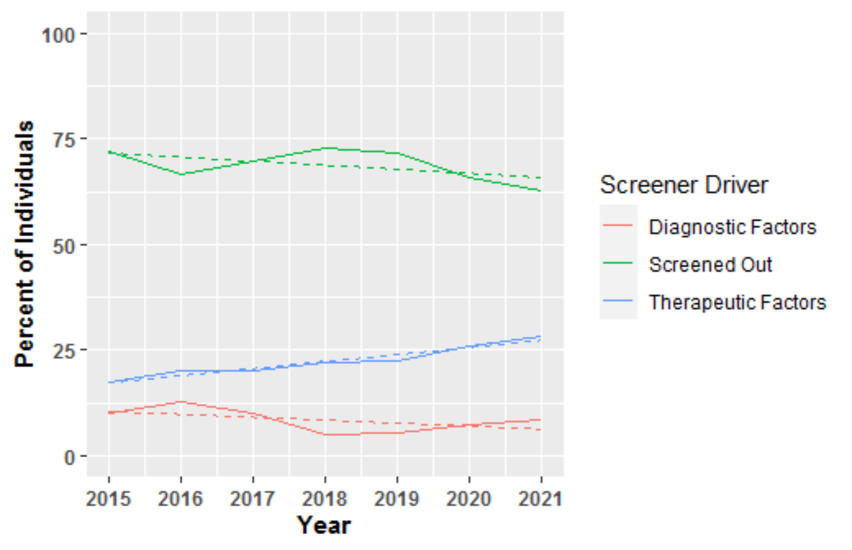
The number of inmates meeting the minimum screening criteria for serious mental illness has been rising since 2015, and currently represents close to a third of all inmates screened.

Slide 20
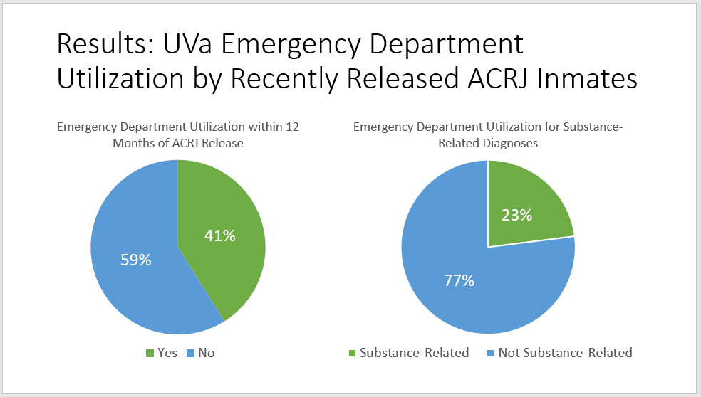
41% of ACRJ inmates require UVa Hospital Emergency Department services in the year following their release. Nearly one quarter of these services are substance abuse-related.

Slide 21
The average daily population at ACRJ has fallen 24% since June 2016, and has been cut nearly in half since 2013.

Slide 22
Conclusions
The Charlottesville Metropolitan Statistical Area has among the lowest overall crime rates in the United States.
The Albemarle-Charlottesville Regional Jail has among the lowest incarceration rates among Virginia’s 26 regional jails.
There are significantly fewer people entering ACRJ on Albemarle and Charlottesville offenses compared to ten years ago. This is especially true of young people (age 18-24).
However, a greater percentage of inmates are being booked in on felonies, and on probation violations, specifically.
This has led to an increase in the average length of stay among both Albemarle and Charlottesville-responsible inmates.
Nevertheless, due to decreases in intake volume, Albemarle and Charlottesville inmates are expending fewer bed days per capita than ten years ago, with the notable exception of inmates age 50 or older.
On an average day, nearly one in three inmates meet the screening criteria for serious mental illness, and nearly half will need emergency health services in the year following their release.
When all is said and done, the average daily inmate population at ACRJ has dropped nearly in half since 2013, even given the upward pressure on the population exerted by Nelson County’s increased jail utilization.

Slide 23
Prepared by:
Neal S. Goodloe, MPA
Criminal Justice Planner
Jefferson Area Community Criminal Justice Board
ngoodloe@oar-jacc.org
October 2022

Slide 25
Neal, I recommend we retain the following slides but pull out of the main presentation. We will refer to them only if needed. Thoughts?

Slide 26
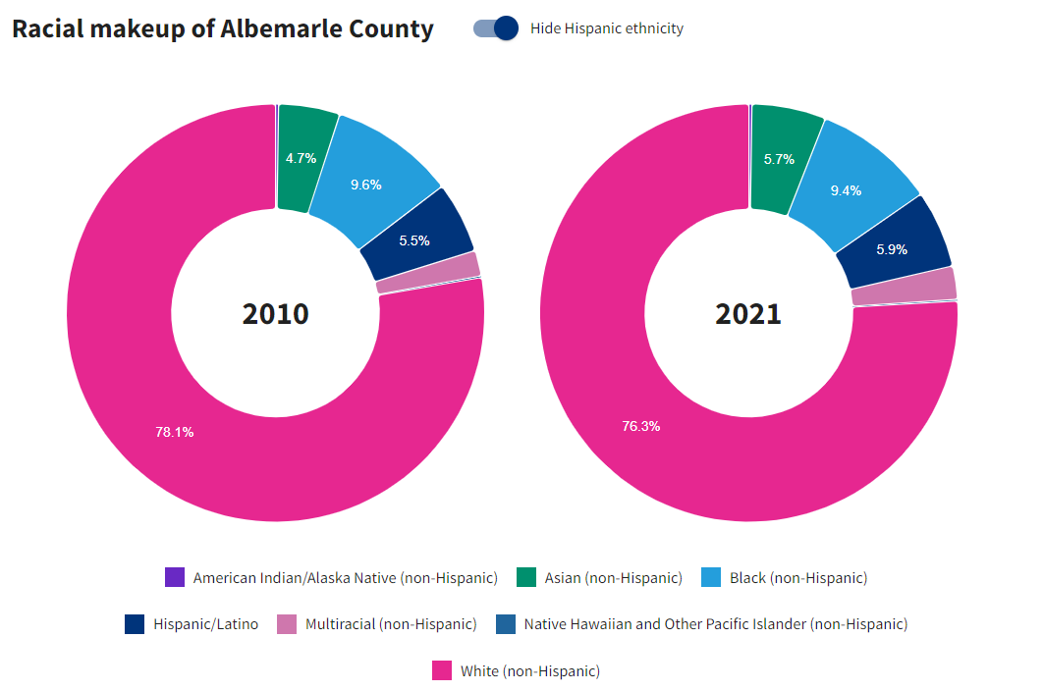
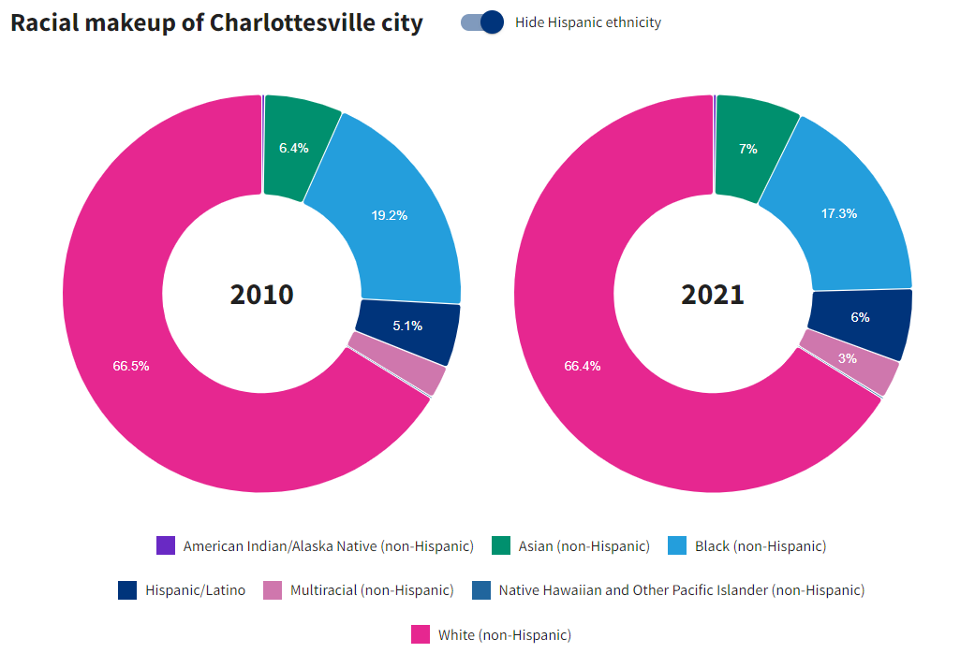
Albemarle has a larger percentage of White residents (76.3%) than does Charlottesville (66.4%). Charlottesville has almost twice the percentage of Black residents (17.3%) than does Albemarle (9.4%).
Source: usafacts.org

Slide 27
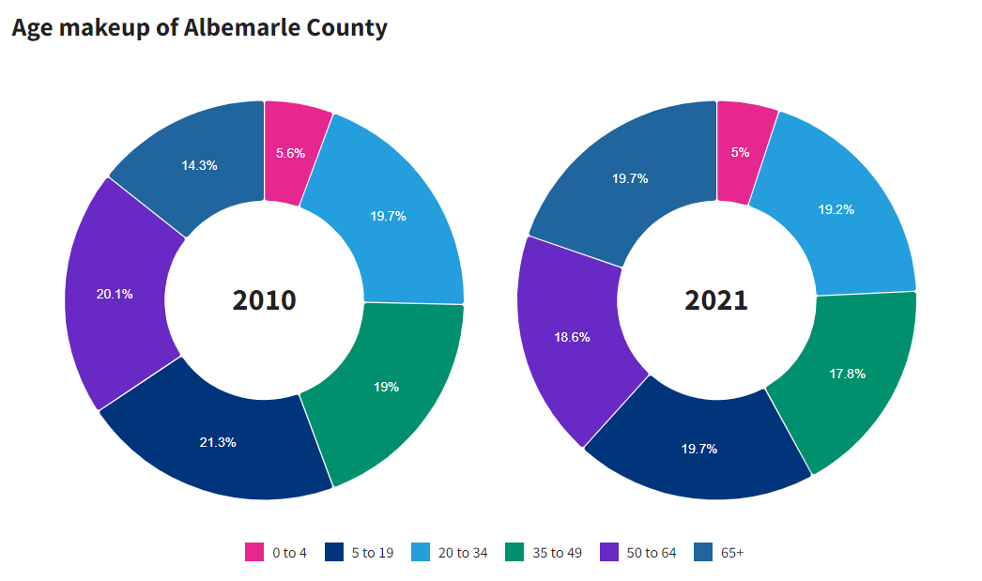
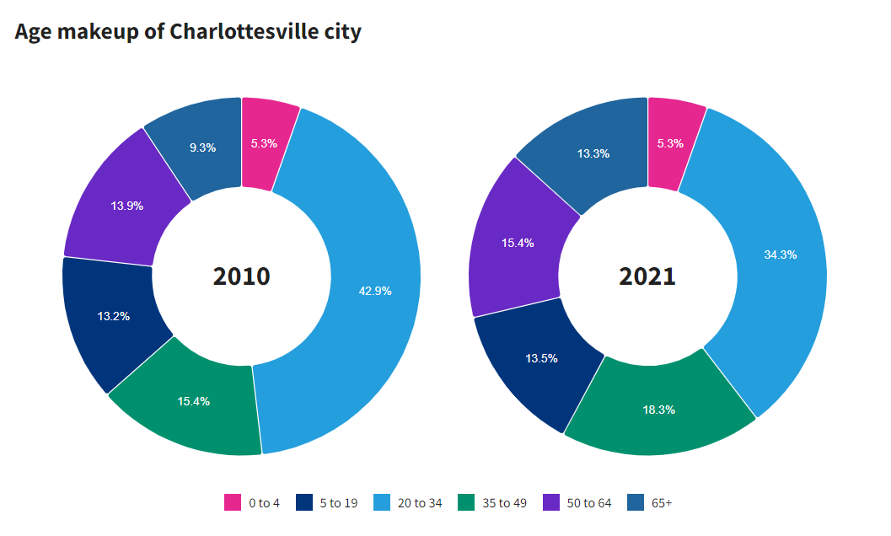
Charlottesville has a higher percentage of residents age 20-34 (34.3%) than does Albemarle (19.2%). Albemarle has a higher percentage of residents age 50 or older (38.3%) than does Charlottesville (28.7%).
Source: usafacts.org

Slide 28
Albemarle’s Group A crime rate was generally on par with other Virginia counties of comparable size, while Charlottesville’s rate was well below that of comparable Virginia cities in every year studied.

Slide 29
ACRJ has the lowest incarceration/crime rate ratio of any regional jail in Virginia.

Slide 30
Felony bookings rose significantly (up 32% in Albemarle but not in Charlottesville (up 1%).
Misdemeanor bookings fell more sharply in Charlottesville (down 42%) than in Albemarle (down 18%).
Felony Bookings up 1%

Slide 31
Bed Days expended on Black inmates fell in both Albemarle (down 16%) and in Charlottesville (down 44%). BDE among White Inmates rose 18% in Albemarle, while falling 39% in Charlottesville.

Slide 32
Specifically, the number of young people (age 18-24) taken into ACRJ on Albemarle and Charlottesville offenses has fallen sharply (down 59% in Albemarle and down 65% in Charlottesville).

Slide 33
Bed day expenditures decreased the most among the youngest inmates (age 18-24), down 37% in Albemarle and down 65% in Charlottesville. Bed day expenditures increased the most among the oldest inmates (age 50+), up 49% in Albemarle and up 19% in Charlottesville.

